Slide 1

Creating a Secure Network
By: Michael Andrews

Slide 2
Executive Summary
You have been hired by an IT company to upgrade their IT systems, but the client has a limited budget and no more physical space to install new equipment.

Slide 3
Services performed
Install VirtualBox and extensions.
Install Router-FW, DNS Server, Webserver, CEO PC, and 3 Kali Linux machines.
Using a browser on the CEO PC, open www.seclab.net.
Documented the OS version, IP address, subnet mask, default gateway address, and DNS server address of the CEO PC, Web server, and DNS server.
Use FTP to download the “Social-Media-Security-Policy” from the Web server to the CEO PC.
Create a new user account on the Web server.
Use nmap on Kali Linux to perform port scans on the DNS and Web servers. Document the open ports on each server.
Verify that the Trusted network is protected from the Untrusted network.
Use Wireshark on Kali Linux to capture an FTP file transfer between the CEO PC and the web server, showing the username and passwords captured by Wireshark

Slide 4
Required Components and software
PC requirements:
PC Minimum Requirements
You must have access to a Windows PC to complete the projects. All projects are performed within a virtual environment.
New Mac computers will not work for the projects.
Minimum hardware requirements:
Intel i3 processor or better, 64 bit. Processors must support virtualization.
8GB RAM memory (16GB highly recommended)
100GB of available main drive space (not USB or external)
Windows 10/11 (Home or Pro) (not S mode)
Software:
Download Virtual Machines
Download VirtualBox and necessary extensions
Screen Pal App for recording

Slide 5
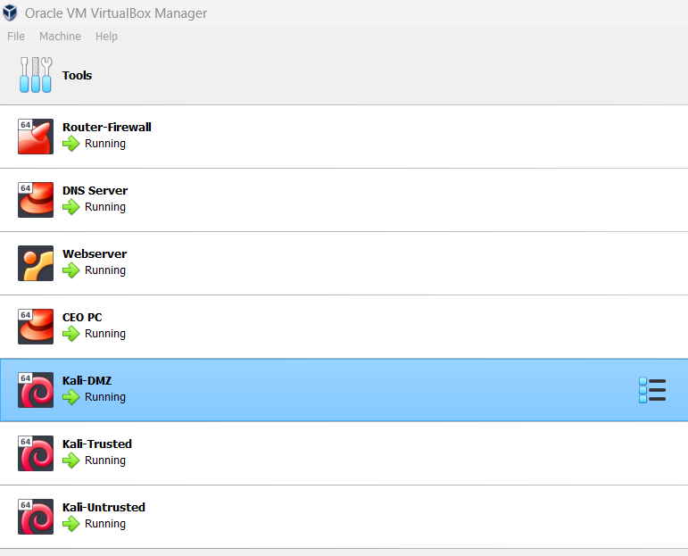
Open www.seclab.net on CEOPC web browser

Slide 6
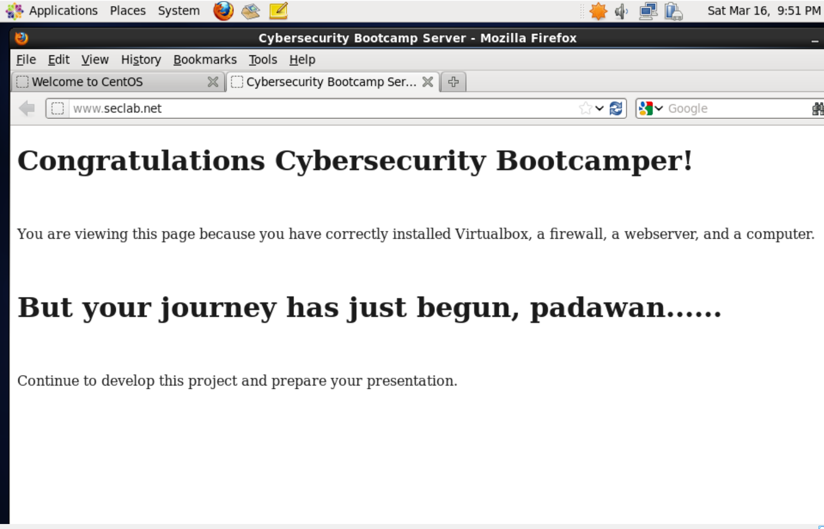
Configure wired network

Slide 7
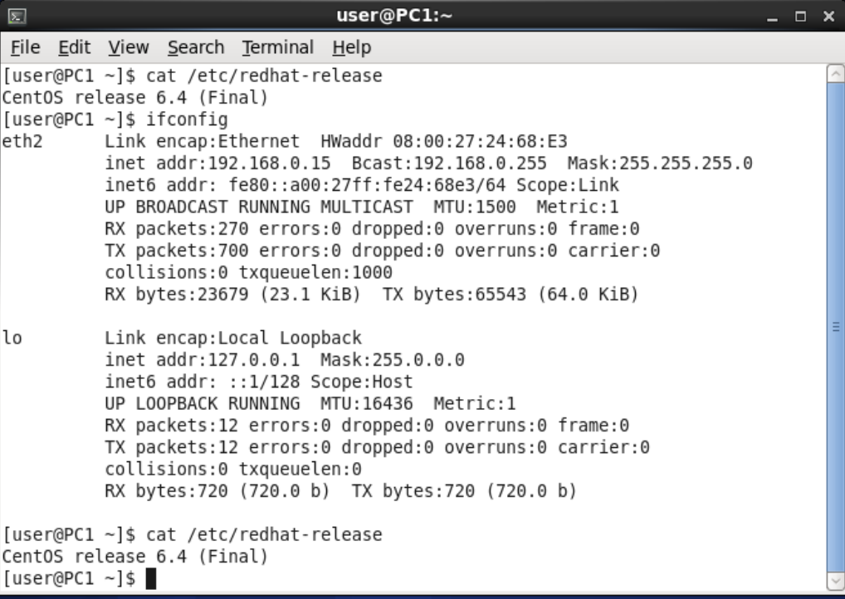
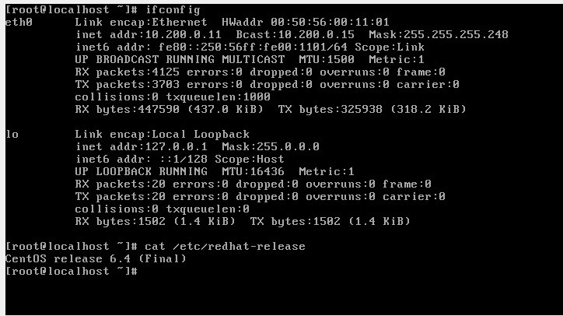
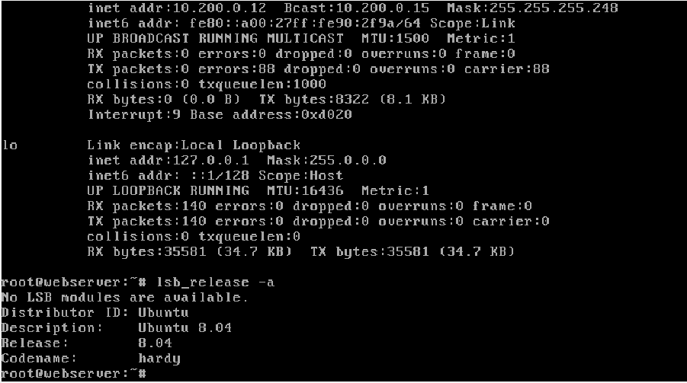
CEOPC
DNS SERVER
DISCOVER AND DOCUMENT
WEBSERVER

Slide 8
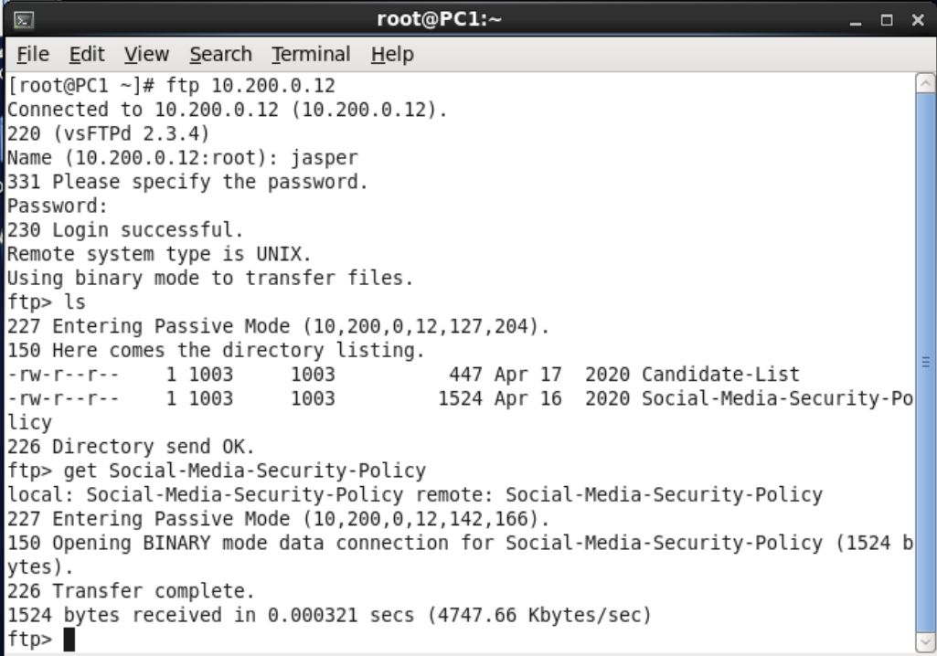
Use ftp to download a file
From CEOPC, you are able to download a file from the webserver.

Slide 9
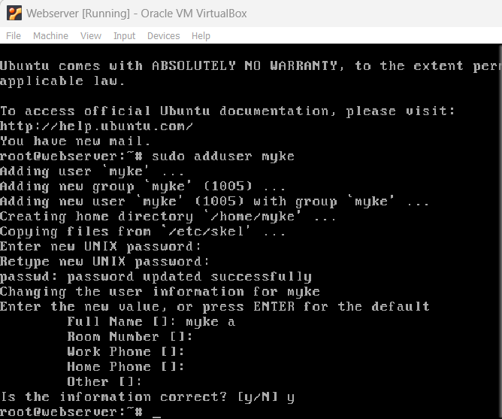
Create a new user account on the Web server

Slide 10
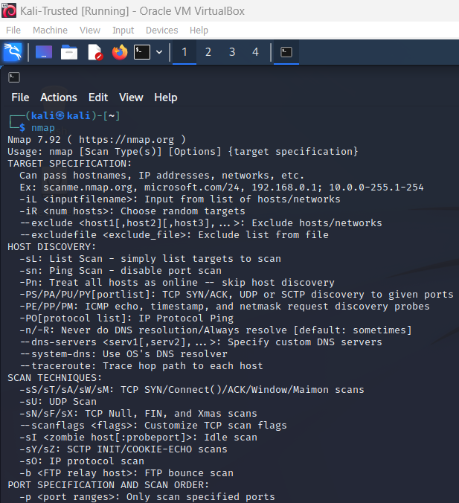
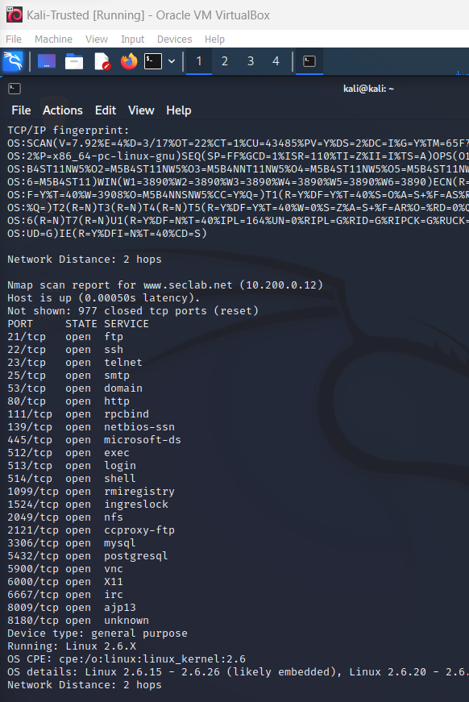
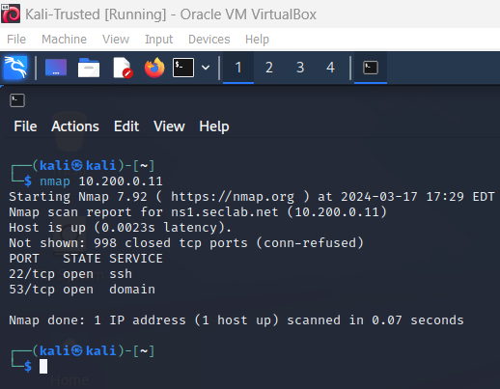
perform port scans on the DNS and Web servers
open ports web servers
open ports DNS servers

Slide 11
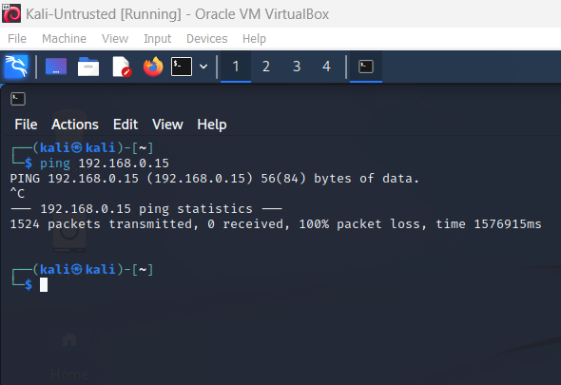
Trusted network is protected from the Untrusted network

Slide 12
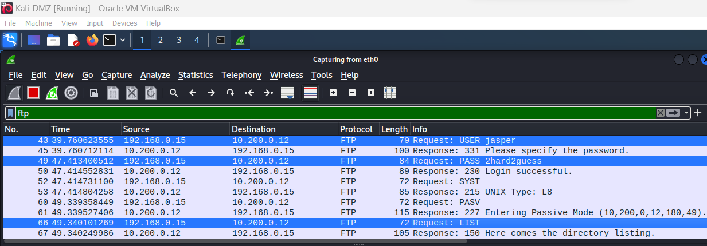
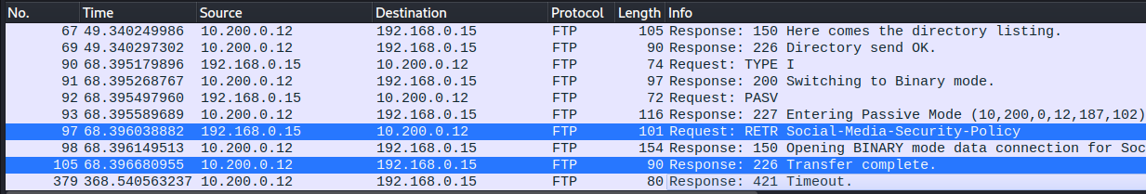
Use Wireshark on Kali Linux to capture an FTP file transfer between the CEO PC

Slide 13

Recommendations
Continue to apply encryption to data
Continue to use a firewall
Establish a VPN
Consistently monitor the network
Install Malware and Antivirus Software
Keep patches up to date
Create strong passwords
Keep software up to date
Educate ALL employees on cybersecurity practices

Slide 14

Thank You
Myke.gsu@gmail.com

